Slide 1
NIEISRTR TOSO

Slide 2
NIEISRTR TOSO

Slide 3
NTRISEIO OTRS

Slide 4
OIRSTEIO NTRS

Slide 5
TRSSTEIO IONR

Slide 6
STOTEIIO RSNR

Slide 7
ISERTION SORT

Slide 8
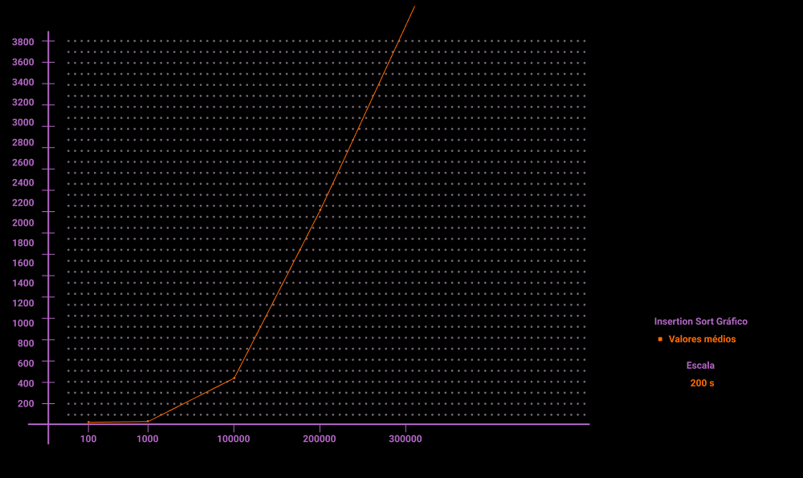
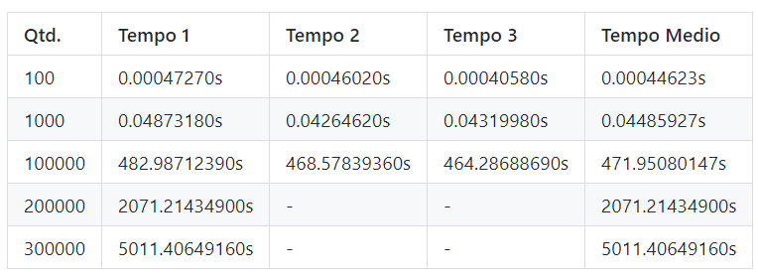

Slide 9
UKTCQI STRO

Slide 10
UTCQKI TSRO

Slide 11
UCQKI SROT

Slide 12
UCKQI RSOT

Slide 13
CQKUI ORST

Slide 14
QUICK SORT

Slide 15
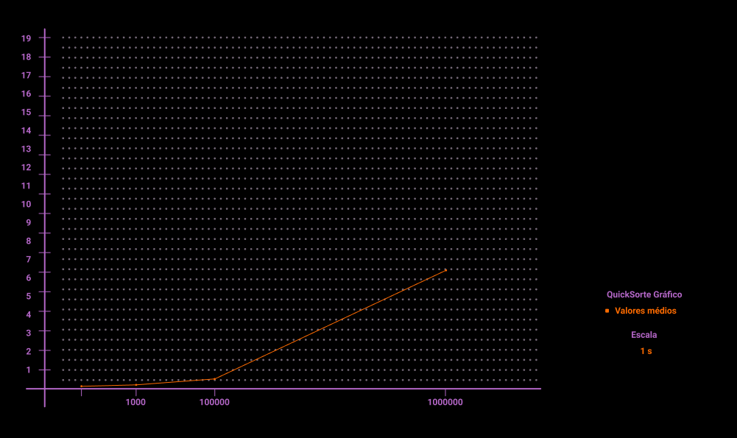
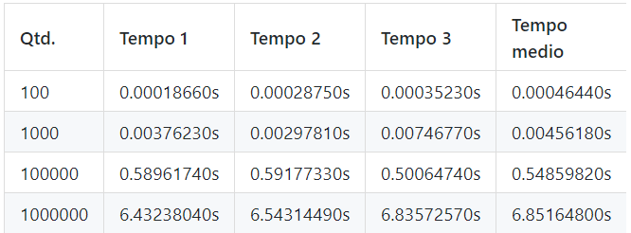

Slide 16
HLESL OSRT

Slide 17
LESHL OTSR

Slide 18
ESHLL SOTR

Slide 19
ELSHL RSOT

Slide 20
LSEHL ORST

Slide 21
SHELL SORT

Slide 22
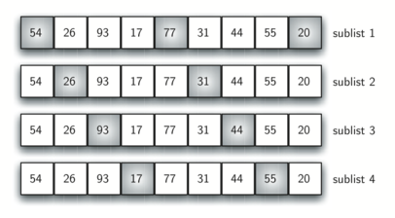
def ShellSort(nums):
h = 1
n = len(nums)
while h > 0:
for i in range(h, n):
c = nums[i]
j = i
while j >= h and c < nums[j - h]:
nums[j] = nums[j - h]
j = j - h
nums[j] = c
h = int(h / 2.2)
return nums

Slide 23
